Slide 1
Book Group Titles
Choosing your next novel
Notes:
· The Secret Life of Bees
· Swamplandia
o this was bought for Am. Lit. book groups in the first place so I’m sure this one is fine for me to use, but I’m putting it on the list anyway
· The Book Thief
· Cold Mountain
· A Thousand Splendid Suns
· A Yellow Raft in Blue Water
o this was bought for Am. Lit. years ago so I’m sure this one is fine for me to use, but I’m putting it on the list anyway—just in case
· The Help

Slide 2
Directions
Pay attention to each of the following novel choices.
Tomorrow, you will be asked to provide your first and second choice of novel to read during this unit.
You will check out books Monday, Jan. 28, 2019.

Slide 3
The Secret Life of Bees
14-year-old Lily, neglected by her father and isolated on their South Carolina peach farm, spends hours imagining a childhood when she was loved and nurtured by her mother, whom she barely remembers. These consoling fantasies are her heart's answer to the family story that as a child, in unclear circumstances, Lily accidentally shot and killed her mother. All Lily has left of her mother is a strange image of a Black Madonna, with the words "Tiburon, South Carolina" scrawled on the back. This is the story of Lily’s search for the truth of her mother, and how she ends up discovering so much more.
Published 2002

Slide 4
The Help
Aibileen is a black maid in 1962 Jackson, Mississippi, who's always taken orders quietly, but lately she's unable to hold her bitterness back. Her friend Minny has never held her tongue but now must somehow keep secrets about her employer that leave her speechless. White socialite Skeeter just graduated college. She's full of ambition, but without a husband, she's considered a failure. Together, these seemingly different women join together to write a tell-all book about work as a black maid in the South, that could forever alter their destinies and the life of a small town...
Published 1997

Slide 5
The Awakening
The Awakening is set in New Orleans and the Southern Louisiana coast at the end of the nineteenth century, the plot centers on Edna Pontellier and her struggle to reconcile her increasingly unorthodox views on femininity and motherhood with the prevailing social attitudes of the turn-of-the-century American South. It is one of the earliest American novels that focuses on women's issues without condescension. It is also widely seen as a landmark work of early feminism, generating mixed reaction from contemporary readers and criticism. The novel's blend of realistic narrative, incisive social commentary, and psychological complexity makes The Awakening a precursor of American modernist literature.
Published 2011

Slide 6
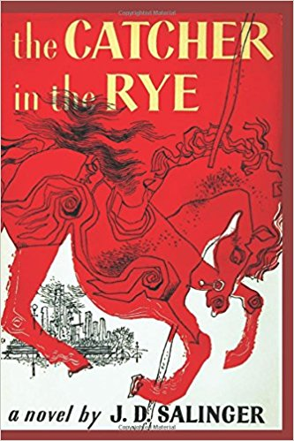
The Catcher in the Rye
The hero-narrator of The Catcher in the Rye is an ancient child of sixteen, a native New Yorker named Holden Caulfield. Through circumstances that tend to preclude adult, secondhand description, he leaves his prep school in Pennsylvania and goes underground in New York City for three days. There are many voices in this novel: children's voices, adult voices, underground voices-but Holden's voice is the most eloquent of all. J.D. Salinger's classic novel of teenage angst and rebellion was first published in 1951. The novel was included on Time's 2005 list of the 100 best English-language novels written since 1923. It was named by Modern Library and its readers as one of the 100 best English-language novels of the 20th century. It has been frequently challenged in the court for its liberal use of profanity and portrayal of sexuality and in the 1950's and 60's, it was the novel that every teenage boy wants to read.
Published 1987

Slide 7
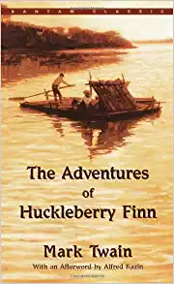
The Adventures of Huckleberry Finn
Adventures of Huckleberry Finn is a novel by Mark Twain, first published in the United Kingdom in December 1884 and in the United States in February 1885. Commonly named among the Great American Novels, the work is among the first in major American literature to be written throughout in vernacular English, characterized by local color regionalism. It is told in the first person by Huckleberry "Huck" Finn, a friend of Tom Sawyer and narrator of two other Twain novels (Tom Sawyer Abroad and Tom Sawyer, Detective). A sequel to The Adventures of Tom Sawyer, the book is noted for its colorful description of people and places along the Mississippi River. Set in the South, The Adventures of Huckleberry Finn is an often scathing satire on entrenched attitudes, particularly racism.

Slide 8
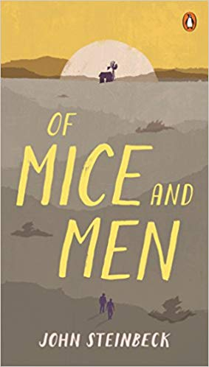
Of Mice and Men AND Old Man and the Sea
The Old Man and the Sea is one of Hemingway's most enduring works. Told in language of great simplicity and power, it is the story of an old Cuban fisherman, down on his luck, and his supreme ordeal -- a relentless, agonizing battle with a giant marlin far out in the Gulf Stream. Hemingway recasts, in strikingly contemporary style, the classic theme of courage in the face of defeat, of personal triumph won from loss. Written in 1952, this hugely successful novella confirmed his power and presence in the literary world and played a large part in his winning the 1954 Nobel Prize for Literature.
Nobel Prize-winner John Steinbeck’s Of Mice and Men is the story of an unlikely pair, George and Lennie, two migrant workers in California during the Great Depression who are grasping for their American Dream.Laborers in California's dusty vegetable fields, they hustle work when they can, living a hand-to-mouth existence. For George and Lennie have a plan: to own an acre of land and a shack they can call their own. When they land jobs on a ranch in the Salinas Valley, the fulfillment of their dream seems to be within their grasp. But even George cannot guard Lennie from the provocations, nor predict the consequences of Lennie's unswerving obedience to the things George taught him.

Slide 9
Now, Do This
Take a ½ sheet of paper and put your name and hour at the top, and answer the following:
Choose the two novels you would most prefer to read and rank them, 1 being your ideal choice with 2 being your backup option.
Name 1 person you would prefer to have in your group if that person chooses the same novel.
Place it in the basket when done.

Slide 10
Book Titles
The Secret Life of Bees
The Help
The Awakening
The Catcher in the Rye
The Adventures of
Huckleberry Finn
Old Man and the Sea/
Of Mice and Men

